Slide 1
Single‑channel EEG measurement of engagement in virtual rehabilitation: a validation study
Virtual Reality 2020

Slide 2
Introduction
1. Engagement refers to mental states, experiences, and processes that foster deliberate and efortful patient commitment to working towards their healthcare goals.
2. There is little work formally evaluating whether VR approaches can, in fact, enhance patient engagement.
3. Electrophysiological methods can provide an objective measure of a user’s immediate responses to VR, which correlate with traditional self-report measures of engagement.
4. A ratio of theta, alpha, and beta EEG activity—has also been used to measure engagement in video game play.
5. Single-channel EEG systems offer a simple and effcient means of data collection while maintaining data quality and reliability.

Slide 3
Introduction
6. The aim of the present study was to provide a proof of concept of a single-channel device to obtain EEG indices of user engagement in VR.

Slide 4
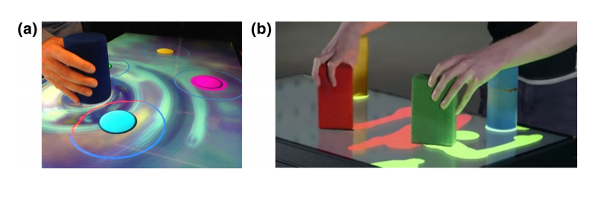
Materials and methods
1. Participants
(1) 25 participants(17 female, average age = 26.7 years)
(2) English speaking, in good health, right handed
2. VR system
(1) Previous evaluations of the EDNA system have identifed strong improvements in motor, cognitive, and everyday performance.

Slide 5
Materials and methods
3. Self-report
(1) The Presence Questionnaire (PQ) version 3
4. EEG acquisition: NeuroSky MindWave devicee (NeuroSky™, CA, USA).
(1) 512 Hz, FP1, Bluetooth, MatLab
5. Procedure
(1) Part one: resting => simulation => resting => simulation , each 2-min in duration
(a) First Resting: sit with eyes closed (rEC)
(b) Second Resting: sit with eyes closed (rEO)
(c) First video: a roller coaster ride (sRC)
(d) Second video: EDNA VR system (sVR)
(2) Part two: play EDNA VR system => PQ-3

Slide 6
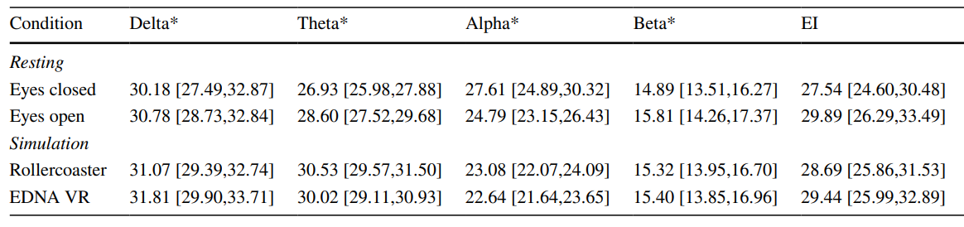
Results and discussion
1. Due to an EEG recording issue, data from one participant was excluded from analysis.
2. For alpha band power, there was a signifcant decrease (p≤0.005) from the resting conditions to the simulation task.

Slide 7
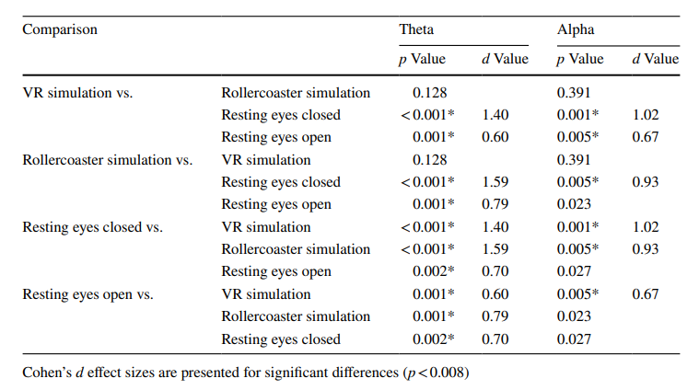

Slide 8
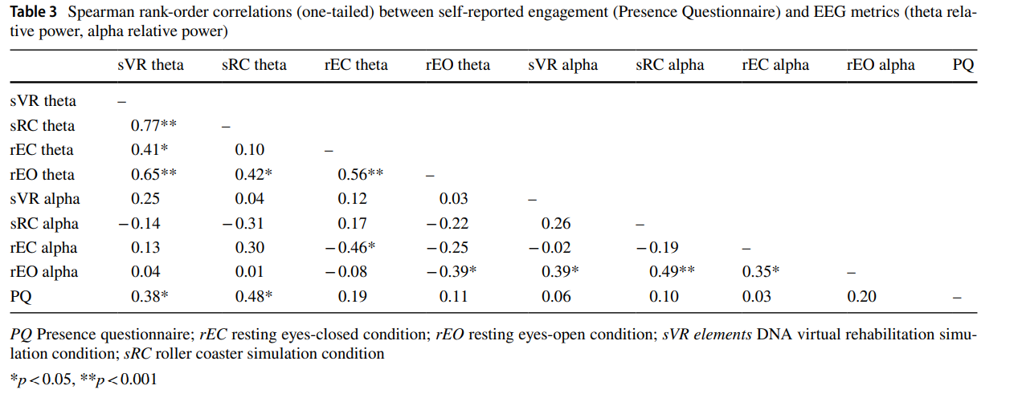
Results and discussion
3. Moderate positive correlations were found between PQ total scores and relative power of theta in the two simulation conditions.
4. There was a negative association between theta and alpha in the resting.

Slide 9
Results and discussion
5. Alpha power in the current study was not correlated with PQ self-report.
6. Theta was particularly sensitive to task manipulations in the level of engagement, and was associated with the subjective self-reported level of engagement.

Slide 10
Conclusion
1. The current fndings suggest that modulation of frontal theta, obtained from a single channel of EEG, expresses the subjective sense of presence induced by the EDNA system.
2. Limitations:
(1) There are no well-established methodologies and agreed-upon evaluation procedures for “engagement”.
(2) Movement artefacts during EEG measurements.
(3) EEG from a single-channel device can be susceptible to eye-blink and eye-movement artefacts.
(4) The current study utilised a convenience sample of healthy adults.

Slide 11
下周计划
1. 继续修改康复系统。
2. 阅读一篇论文。

